Slide 1

Welcome to HeatSync Labs!
We are a 501(c)3 non-profit, we have no employees
Entirely volunteer run
Our goal is to create a space where the public can create things!
For more information about the space and what goes on here, please visit http://www.heatsynclabs.org

Slide 2
Mechanical Assembly

Slide 3
Inventory
Pen Arm Proximal
Pen Arm
Distal
Ⓔ
M8x60
Ⓖ
Ⓗ
Ⓘ
Ⓙ
Ⓚ
Idler Brace
Ⓛ
Ⓒ
Ⓕ
Ⓑ
13 M3x25
1x metal
1x nylon
M4
Pen Holder
1
M3x30
¾” x ½” Spring
Drive Brace
Ⓟ
2 nylon
1 metal
M4 Nut
Ⓝ
Ⓣ
Ⓢ
Ⓡ
Ⓠ
6x
M3 Nut
(1 with silvered side)
M4 Washer
Ⓓ
Egg Holder
Drive
22x
M8 Nut
2x
NEMA 17
Steppe Motors
Ⓨ
Pen Arm Shaft Coupler
2x
Bearing Mount
Egg Holder
Idler
Ⓧ
Ⓜ
Ⓞ
Arduino Holder
2x
Skateboard
Bearings
Ⓥ
Ⓤ
Ⓦ
③
9g Servo
M8 Washer
Ⓩ
②
2x
Table Rest
Ⓐ
①
4
M3 Standoff
2x
Dart Tips
3x
M8 Threaded Rod
2x
Egg Axis Plate
Pen Axis Plate
ⒶⒷⒸⒹⒺⒻⒼⒽⒾⒿⓀⓁⓂⓃⓄⓅⓆⓇⓈⓉⓊⓋⓌⓍⓎ①②③④⑤⑥⑦⑧⑨⑩

Slide 4
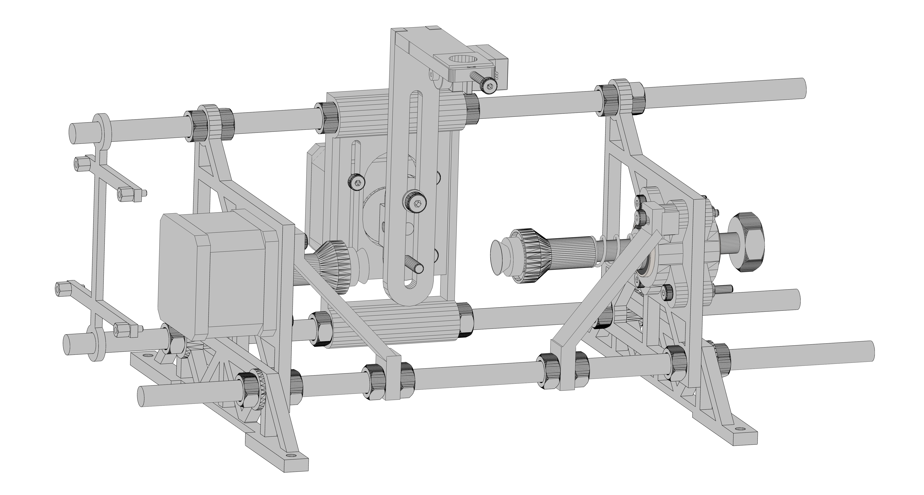
Final Assembly

Slide 5
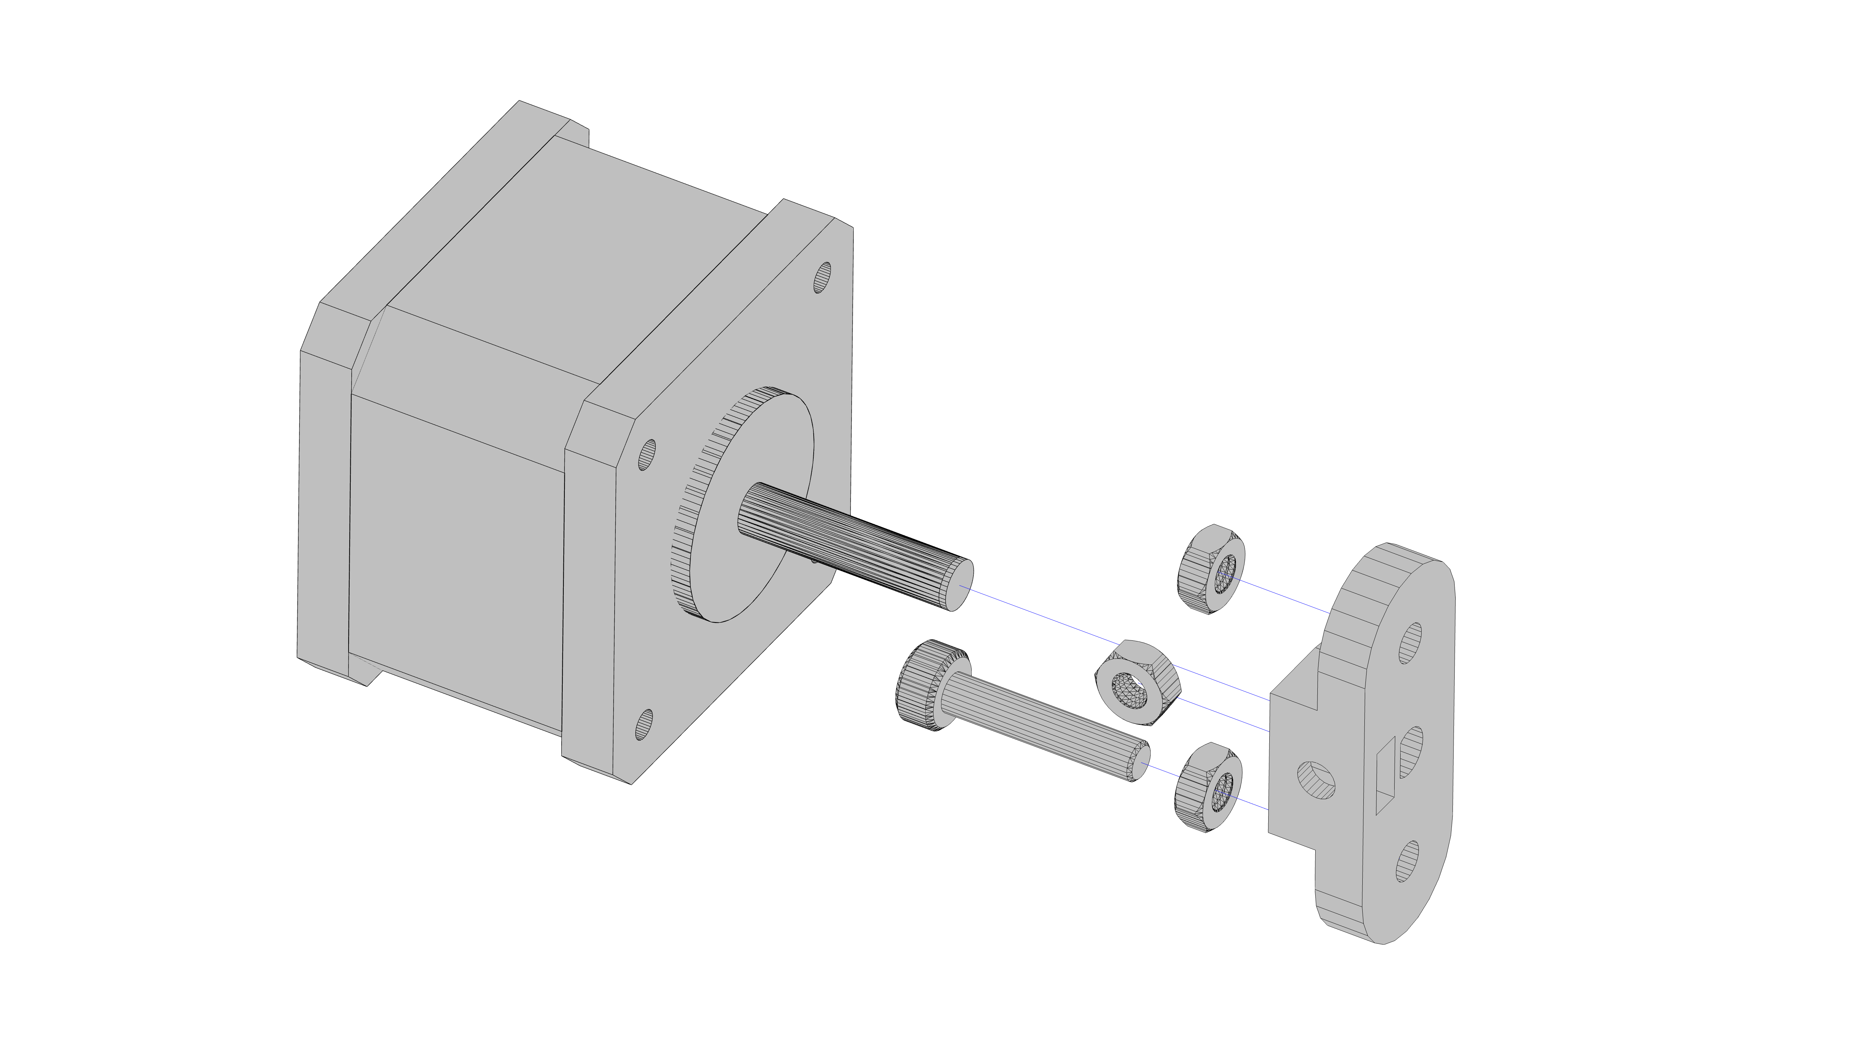

STEP 1
Ⓓ
Press in nuts using clamp
Push coupler onto shaft against table
Motor shaft should be flush
Note: Nuts do not go flush
M4 Nut - Metal
3xⓅ
Ⓘ
Ⓨ
M4 Bolt – nylon (shorter)

Slide 6
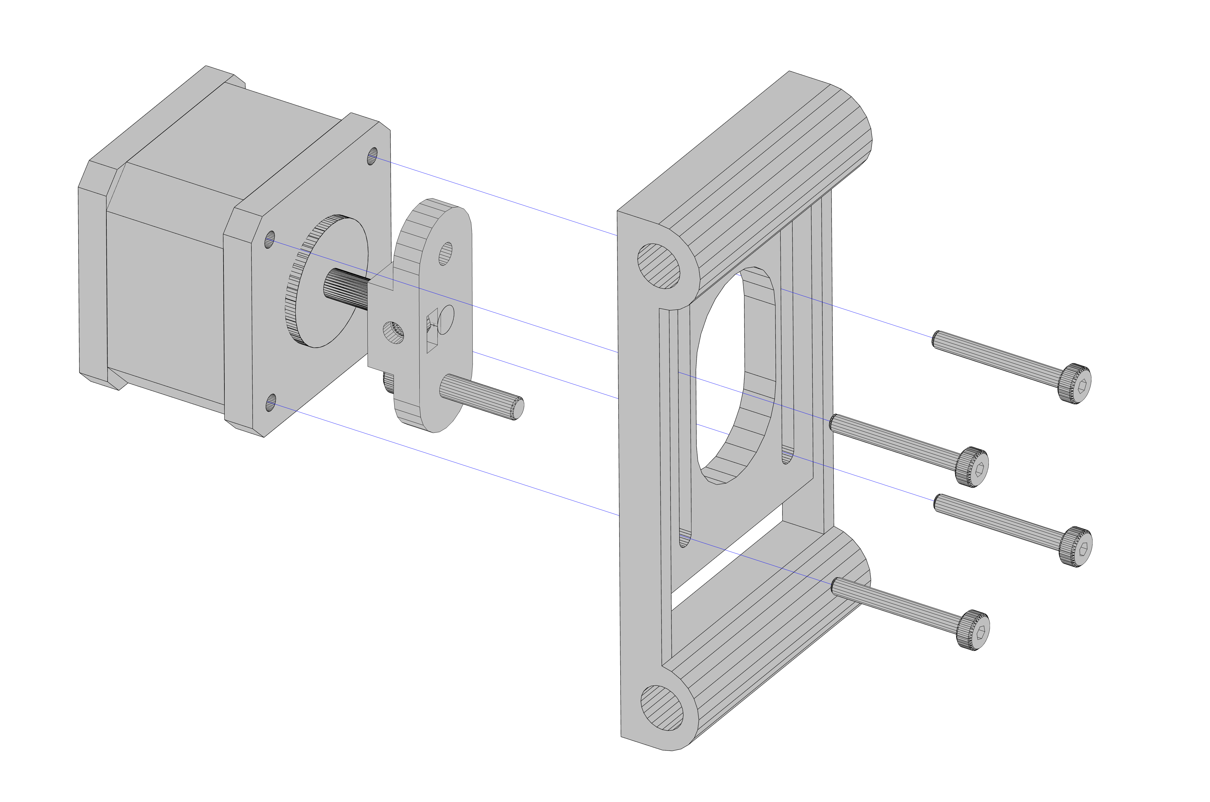
STEP 2
Ⓤ
4xⒼ
Trim nylon screws using 1 green spacer + 1 purple spacer

Slide 7
STEP 3
Ⓙ
This M3 nut has a SILVER side that must face up!
Ⓢ
Ⓕ
Ⓖ
Ⓔ

Slide 8
STEP 4
Use one of the two long screws that comes in the servo bag to attach
③
Ⓠ
Ⓘ
M4 nut, metal

Slide 9
STEP 5
(center onto rods)
Ⓡ
Ⓐ
Ⓡ
Ⓡ
Ⓡ
Ⓐ

Slide 10
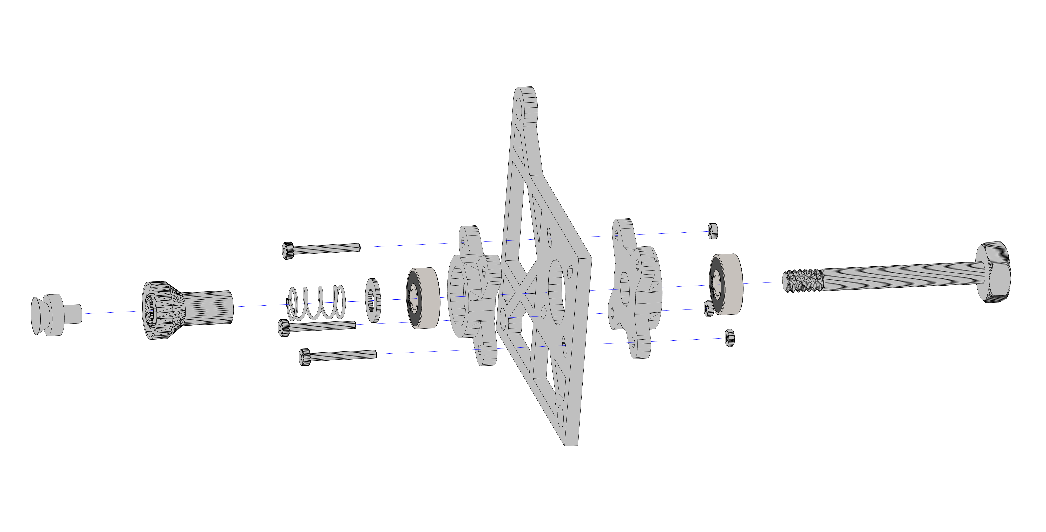
STEP 6
Update: The head screws off of the new version and installs from the left!
Ⓥ
Ⓝ
Ⓝ
3xⓈ
3xⒼ
Ⓞ
Ⓞ
Ⓛ
Ⓧ
Ⓩ
①
Ⓚ

Slide 11
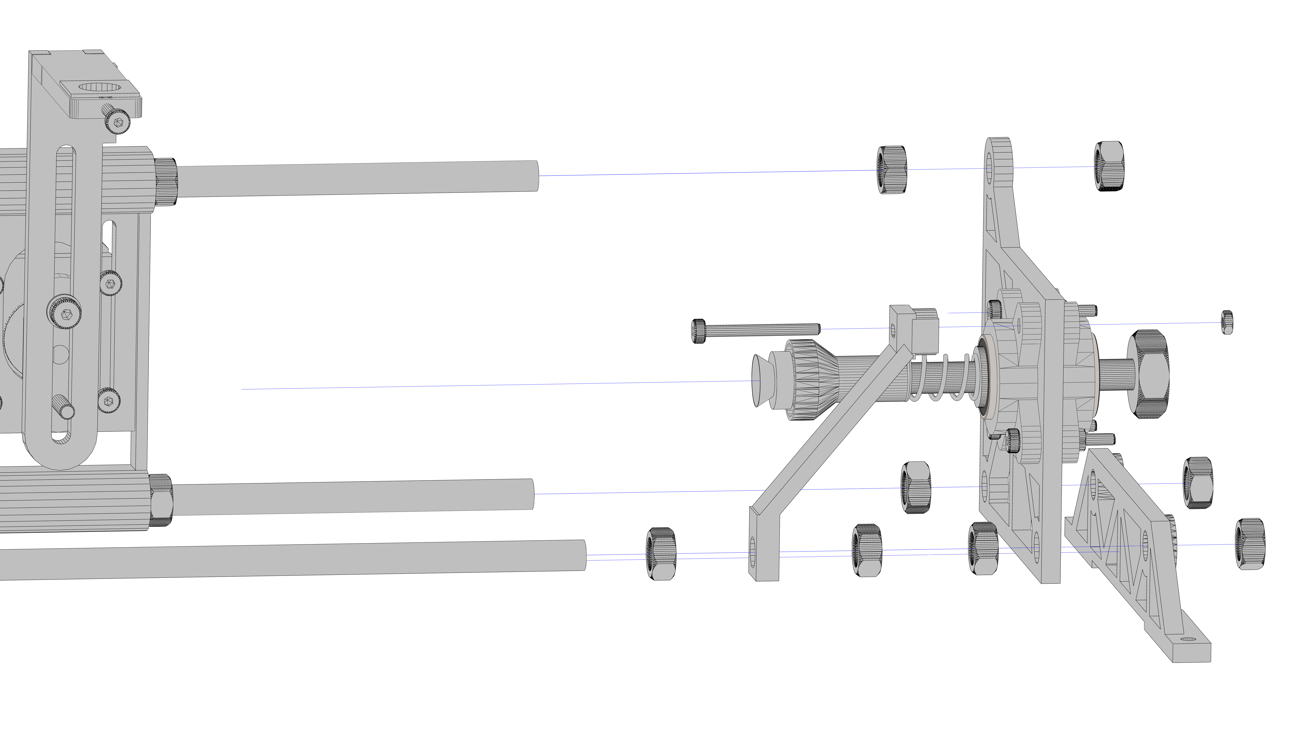
STEP 7
Ⓡ
Ⓡ
Ⓗ
Ⓢ
Ⓡ
Ⓡ
Ⓡ
Ⓡ
Ⓡ
Ⓒ
Ⓡ
Ⓜ

Slide 12
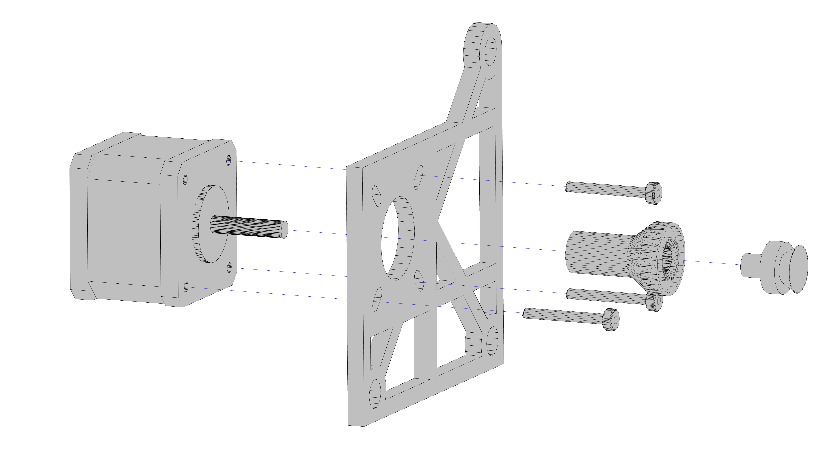
STEP 8
Ⓥ
Ⓓ
Trim these bolts!
use 1 green spacer + 1 purple spacer
Ⓣ
①
3xⒼ

Slide 13
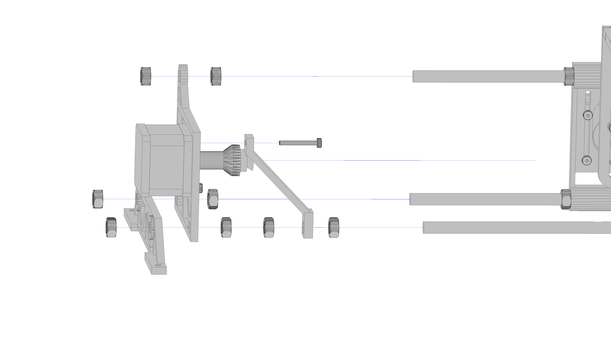
STEP 9
Ⓡ
Ⓡ
Ⓖ
Trim this bolt! use 2 green spacers
Ⓡ
Ⓡ
Ⓡ
Ⓡ
Ⓡ
Ⓡ
Ⓑ
Ⓜ

Slide 14
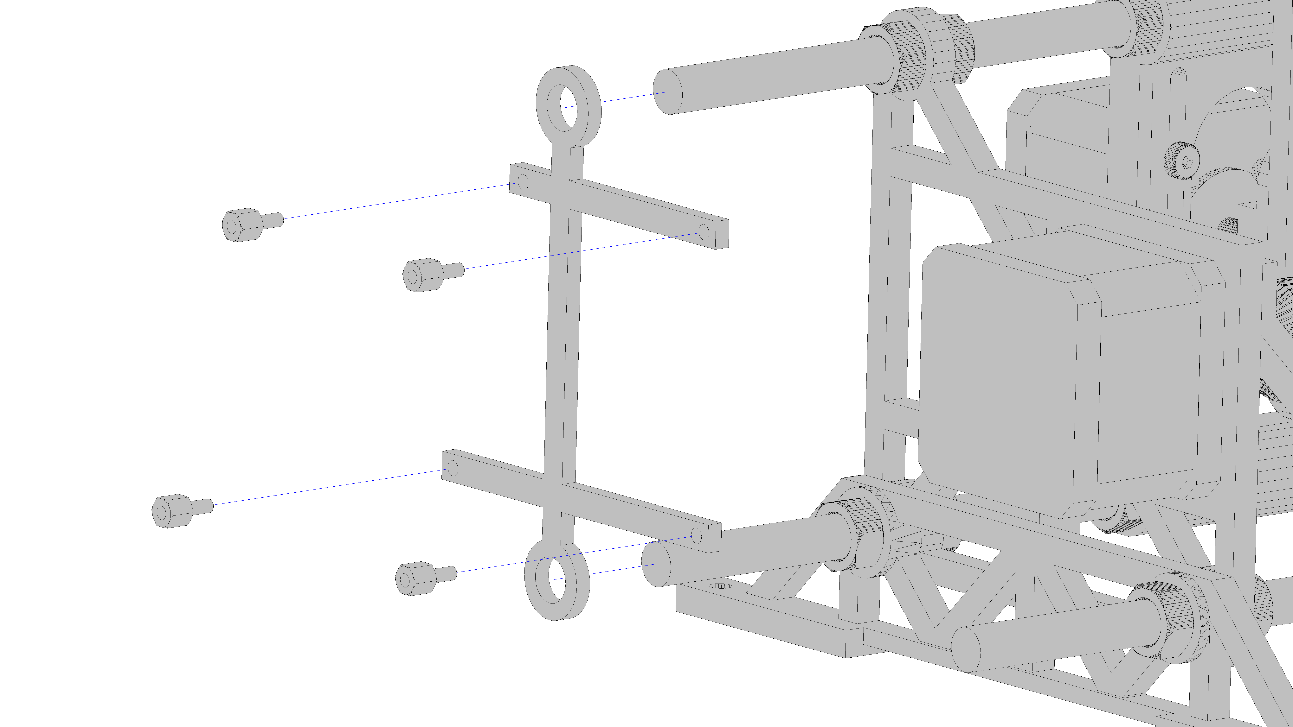
STEP 10
②
②
Ⓦ
②
②

Slide 15
Electrical Assembly

Slide 16
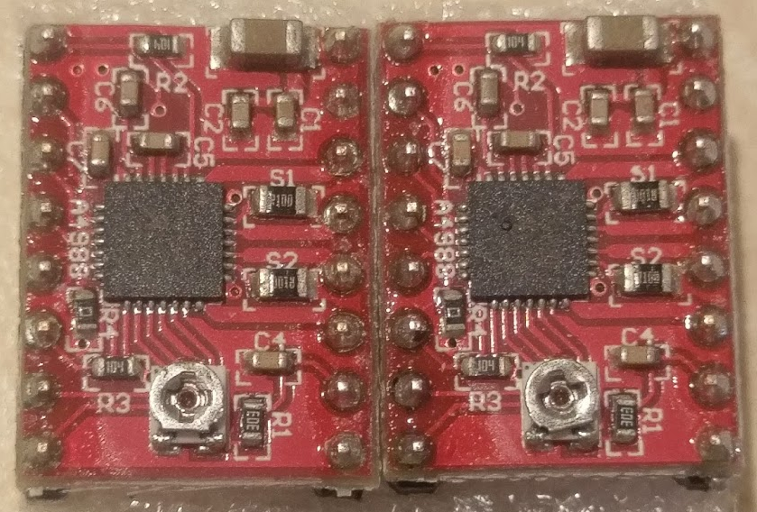
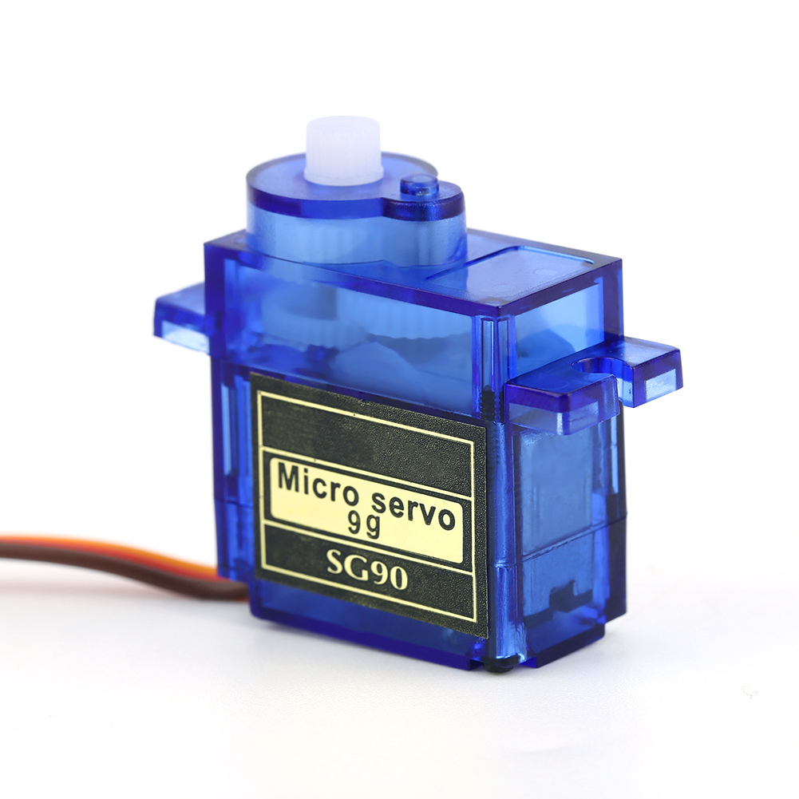
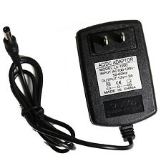
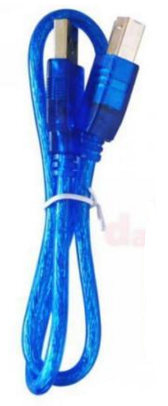
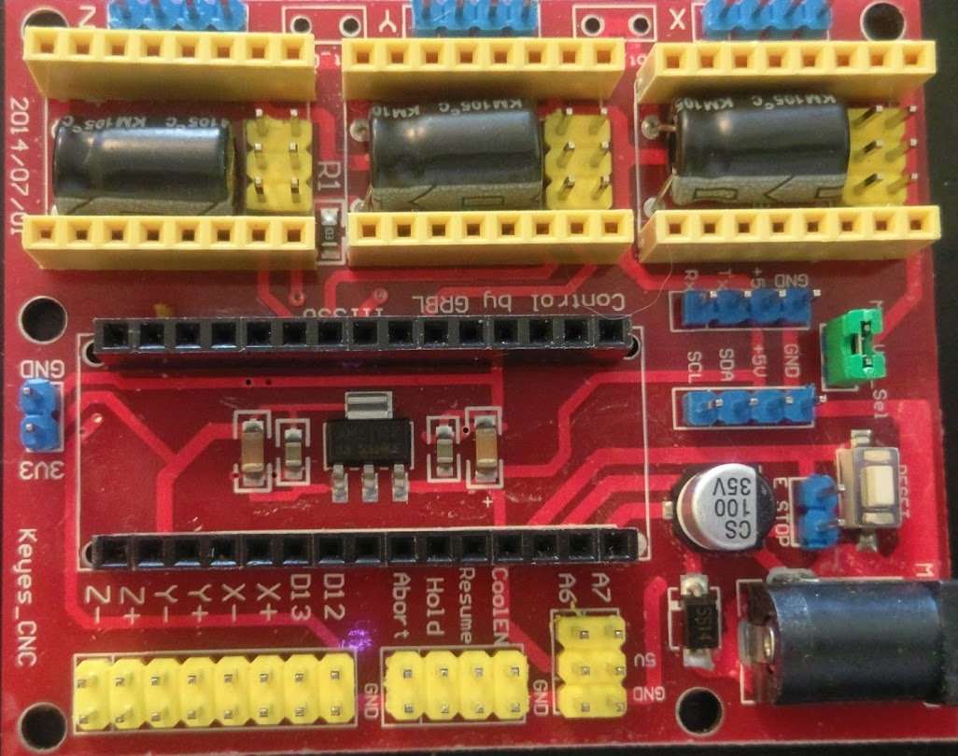
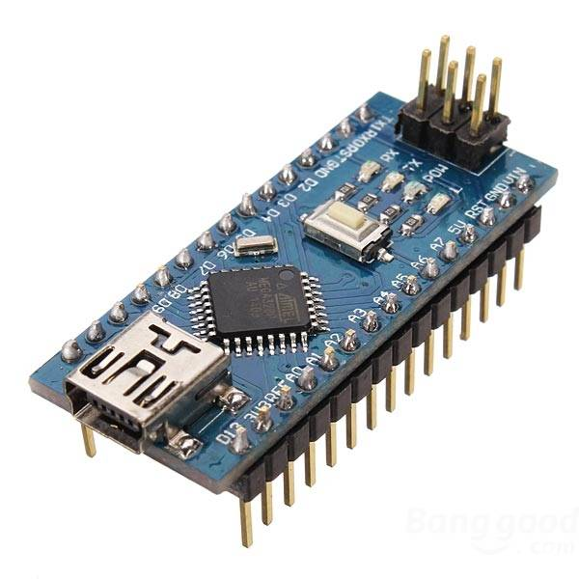
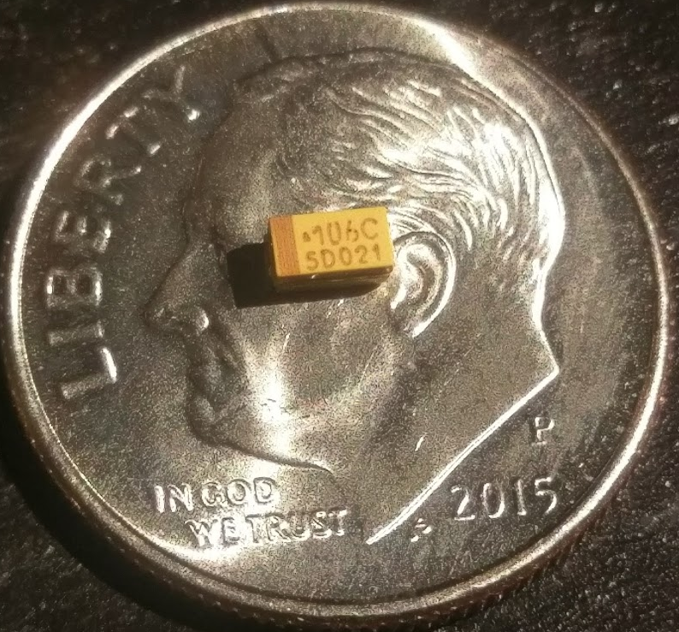
Electronic Inventory

Slide 17
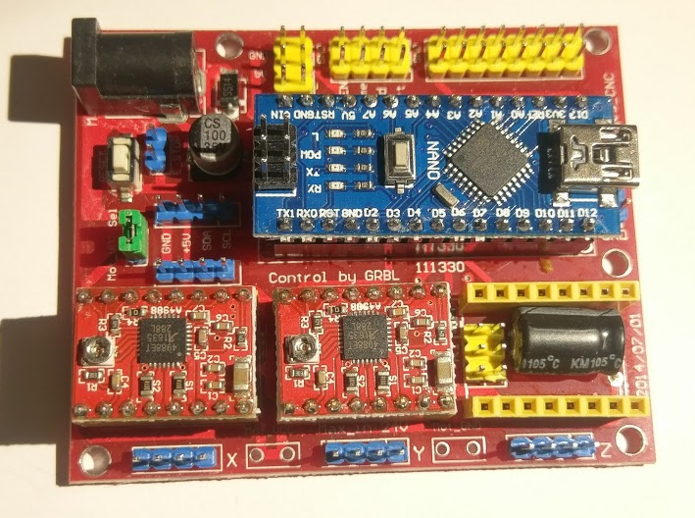
Controller Anatomy
Arduino Nano
12V power →
Pen arm lifter upper Servo
USB to Computer (Data port)
A4988 Stepper Motor Drivers
Egg
Axis
Connector
Pen
Axis
Connector
Spare
(For future world domination?)

Slide 18
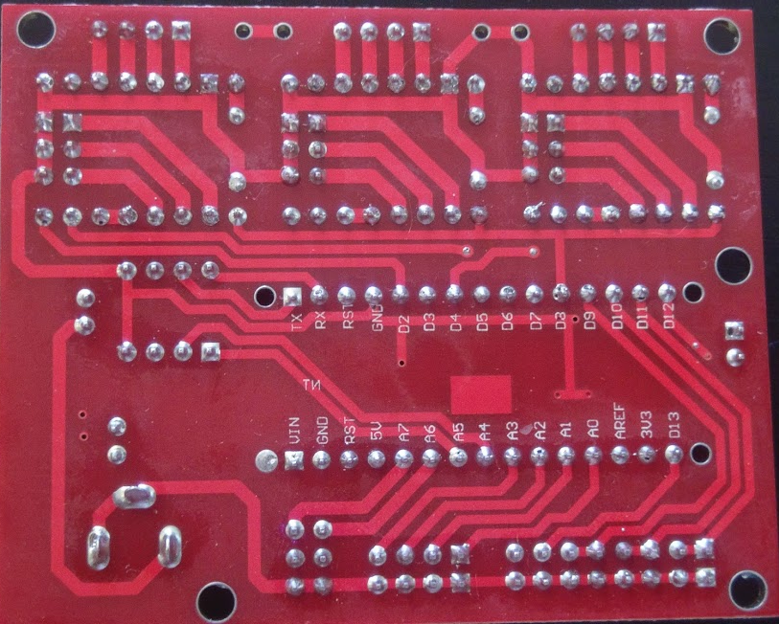
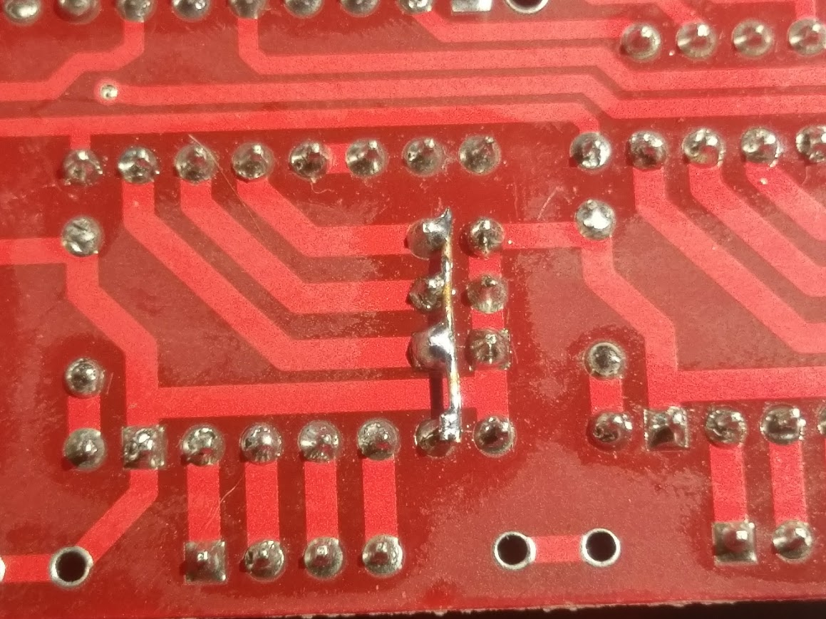
Hack the Mainboard Pt I
Remove all the green jumpers from these three areas. They must be all gone, like this!
There is a mistake on the board. These four pins MUST be connected together!
Solder them together, like this. Do this for all three sets.

Slide 19
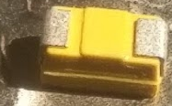
Hack the Mainboard Pt II
This is a capacitor. It has a front, and a back. The positive, + side is marked with a darker stripe. Yes, it is tiny!
This is the reset pin. We need to keep it from resetting every time we connect to the board. To do this, we will add a capacitor.
+

Slide 20
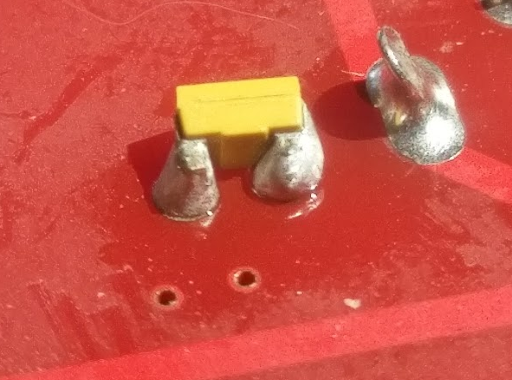
Hack the Mainboard Pt II
Place the capacitor sideways next to the reset pin pair. Gently touch each leg with the soldering iron on the FAR side of the capacitor.
Done!
Heat from THIS side
Pay careful attention to the dark stripe, it must be facing the right way!

Slide 21
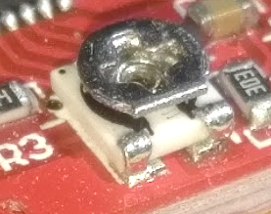
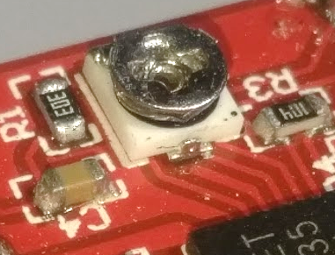
Stepper Motor Drivers
Have a friend turn the dial while you measure with a meter!
These tiny boards are called drivers, because they control the motors.
They need to be adjusted for the motors we are using.
The formula is Voltage = Amps * 0.8
Our motors need 0.35 Amps, which means 0.35*0.8 = 0.28 Volts
Measure here
And here
Insert the drivers into the main board, like this. Pay attention! If you plug them in backwards you will fry them!
Here’s another
view

Slide 22
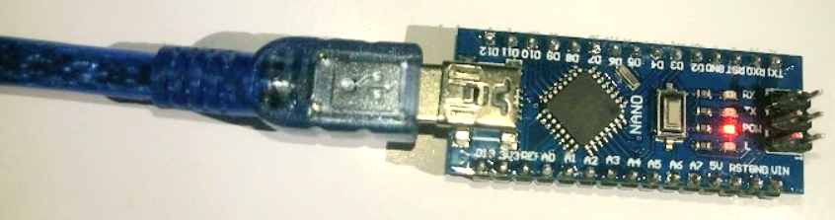
Program your Arduino
Remember when we soldered that capacitor? It keeps the Arduino from resetting, which means we can’t program it when its plugged in.
To program the Arduino, first install the file in the Step-1 folder on the thumb drive.
  Plug in your Arduino to the blue cord, then to your PC
  Open the subfolder EggDuinoNanoJN and run ‘EggDuinoNanoJN.ino’
  This will launch the Arduino IDE, wait for it to pop up
  Run Sketch->Upload to program the Arduino. Unplug when done and close Arduino

Slide 23
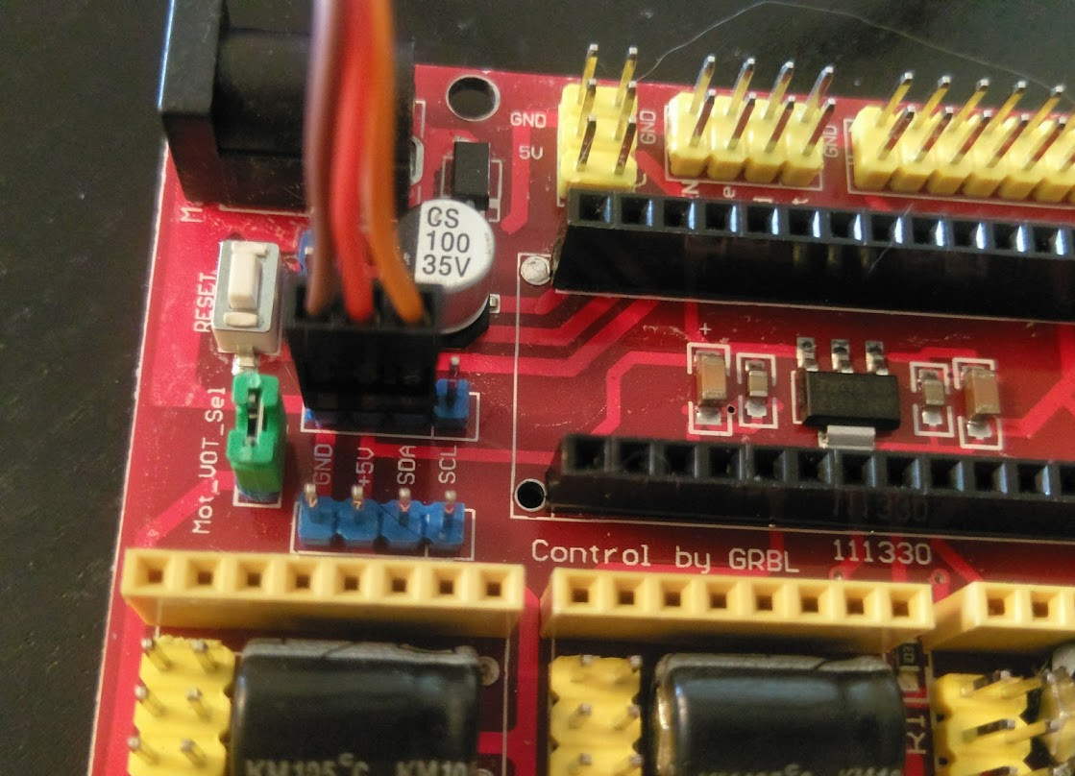
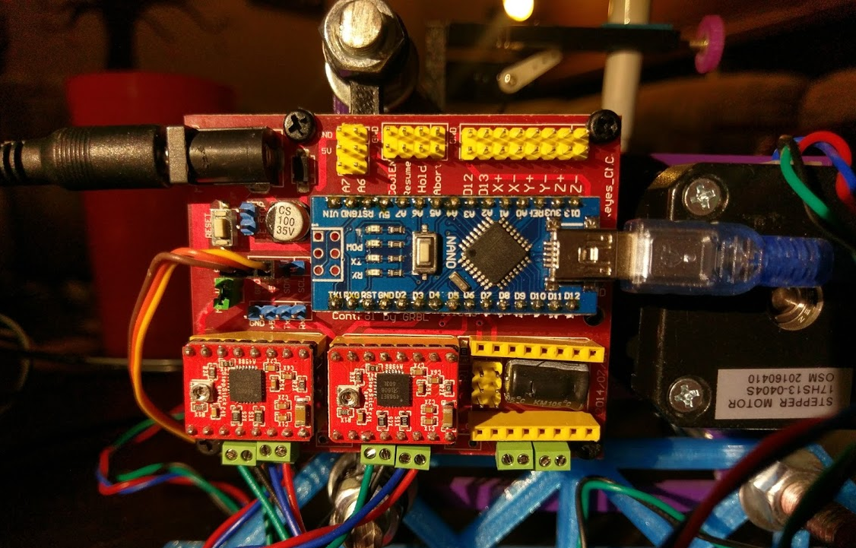
Insert your Arduino and hook it all up!
Be careful not to get it backwards!
← The USB is here
The servo goes on these three pins. Brown must be hooked to the pin labeled GND
The stepper motor wires go green to the LEFT as shown here

Slide 24
Power it up!
It’s go time! But before we apply power, have an instructor do a once-over to make sure everything is as it should be to avoid damaging anything.
Ok? OK! Plug the 12V power adapter into a wall outlet then into the controller board.
If you did everything right, both stepper motors and the servo should come ALIVE for about a second, then relax.
If either nothing happens OR something horrible happens, remove power IMMEDIATELY and ask for assistance (DON’T PANIC!) ☺

Slide 25
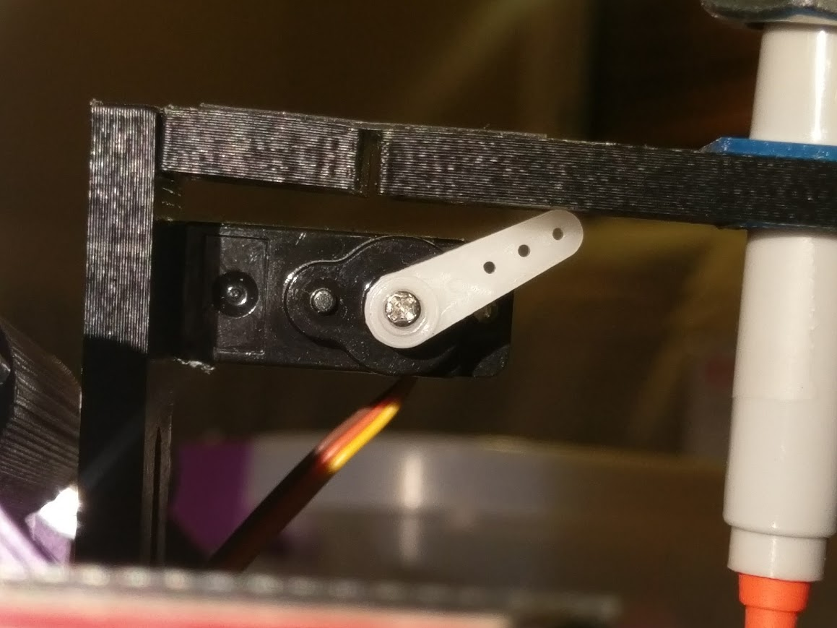
Add Servo Horn
Servos are motors that move through small carefully controlled range
  They do not make a full circle, usually 180 Degrees, a half circle.
  When we powered on the device, the stepper was commanded to its home position.
  Now we can add the last piece, the horn.
Press the horn onto the shaft so that it just touches the plastic but does not lift it up.
It is better to have a small gap than to push the arm up.
Secure with the SMALL screw from the servo baggie.
Servo Horn

Slide 26
Pen Holder
Servos are motors that move through small carefully controlled range
  They do not make a full circle, usually 180 Degrees, a half circle.
  When we powered on the device, the stepper was commanded to its home position.
  Now we can add the last piece, the horn.
Press the horn onto the shaft so that it just touches the plastic but does not lift it up.
It is better to have a small gap than to push the arm up.
Secure with the SMALL screw from the servo baggie.
Servo Horn

Slide 27
Software Setup

Slide 28
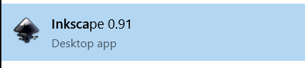
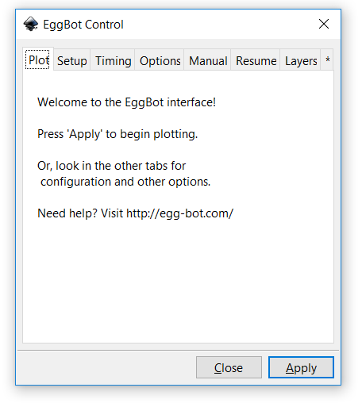
Install Inkscape
Run the files located in the step-2 directory on the thumbdrive
  This will install inkscape and the eggbot extensions from Evil Mad Scientist
Run Inkscape, and open the Eggbot Extension

Slide 29
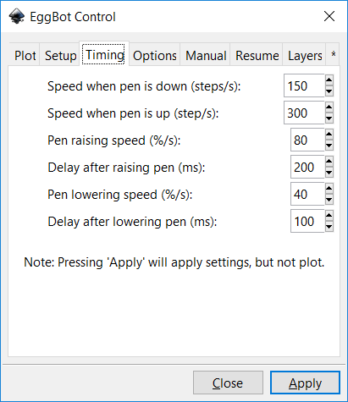
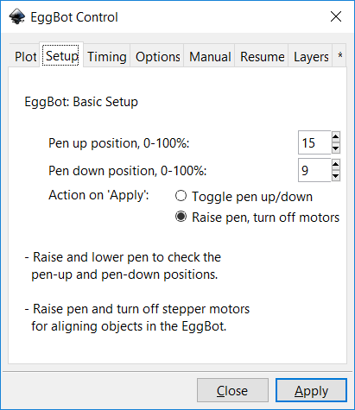
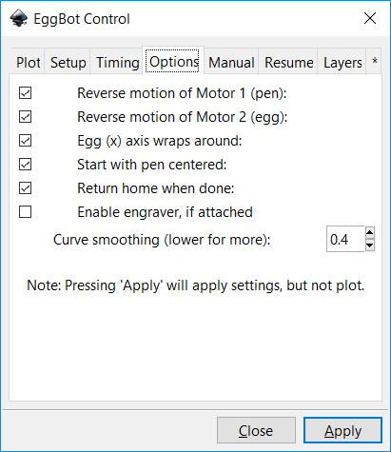
Setup EggBot Control
The following screens show the settings for use on your robot.
Keep this as a reference

Slide 30
Forward!
Visit http://wiki.evilmadscientist.com/The_Eggbot_Extensions for a wonderfully written tutorial on how to use Inkscape to generate art!

